Slide 1
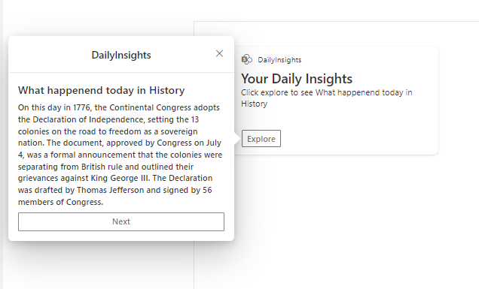
Daily Insights with ChatGPT
PrimaryTextCard-ChatGPTDailyInsights
Siddharth Vaghasia (@siddh_me)
Kunj Sangani (@kunj-sangani)

Slide 2





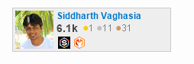






Siddharth Vaghasia
Microsoft 365 | Founder | BinaryRoots
SharePoint, Teams App, Power Platform, Azure, .NET
https://siddharthvaghasia.com
https://c-sharpcorner.com/members/siddharth-vaghasia
@siddh_me
siddharth-vaghasia
https://www.linkedin.com/in/siddharthvaghasia

Slide 3

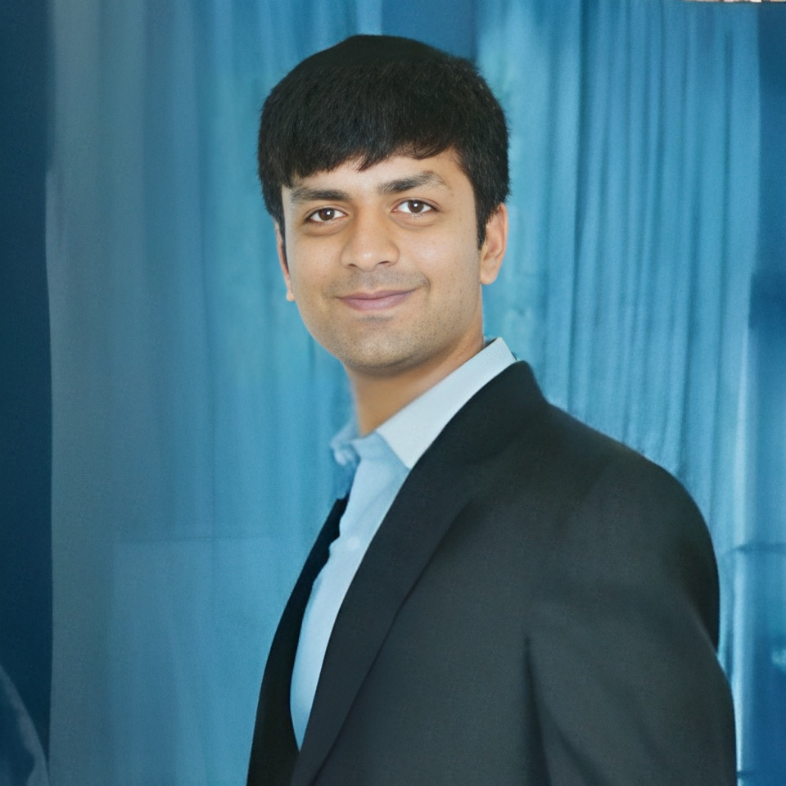


Kunj Sangani
Technical Consultant - SharePoint, Office 365, Azure, .NET, NODE JS
Speaker | Blogger | PnP contributor | C# Corner MVP
https://www.c-sharpcorner.com/members/kunj-sangani
@sanganikunj
https://www.linkedin.com/in/kunjsangani
kunj-sangani
sangani.kunj@gmail.com
kunj.sangani

Slide 4

PrimaryTextCard-ChatGPTDailyInsights
ACE to display Daily Insights based on ChatGPT OpenAI API
https://github.com/pnp/sp-dev-fx-aces/tree/main/samples/PrimaryTextCard-ChatGPTDailyInsights

Slide 5

Idea
Utilize an Adaptive Card extension to send pre-configured prompts to the ChatGPT API, retrieve responses, and display them in a Quick View format
Driving factors
Explore Open AI API and Prompt Engineering
Enabling ChatGPT to deliver customized daily insights to individual users
Calling External APIs from ACEs.
Explore OpenAI API and Prompt Engineering
Enabling ChatGPT to deliver customized daily insights to individual users
Calling External APIs from ACEs.

Slide 6
Summary
This card can be configured to show
Quote of the day
Fact of the day
Tip of the day
What happened today in History
Grammar Tip
Motivational Words
Life Hack of the day
Health tip of the day
Meditation tip of the day
Coding tip
Below are configurable options
API Key
Select Prompt/Category
Max Token, refer this link to understand rate limit
Card Title and Description.
Using Session Storage to store the response per session to limit number of request per user.
Allowing user to Use Next button to get new response(limits to 5, to save requests)

Slide 7
Warning
It is advisable to have call API from server side

Slide 8
Demo/ Code Walkthrough

Slide 9
THANK YOU

